Slide 1
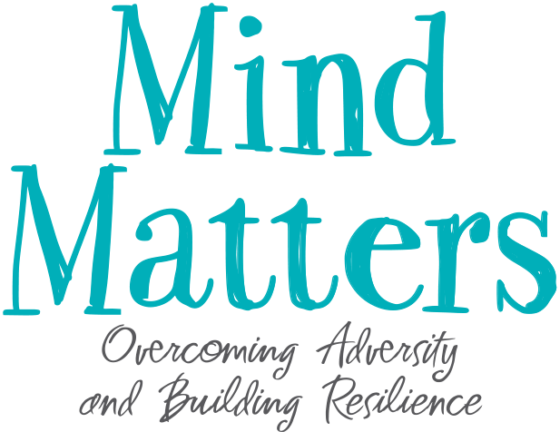

Slide 2

Mind Matters:
A Tool Kit for Empowerment
Notes:
1.1 Introduction to Mind Matters (pg. 2)
Introductions:
Introduce yourself and your co-leader.
Have each participant share their name and something else about themselves.
Discuss General Logistics
Create a Safe Environment:
Group agreements (including respect, confidentiality, mandated reporting)
Please share:
“The various skills and exercises we will be teaching are designed to change levels of personal awareness. If anyone experiences discomfort with a skill, please stop your practice, sit quietly, and relax. Should the uneasiness continue, raise your hand so you can be helped.”

Slide 3


Lesson 1: Self-Soothing

Slide 4
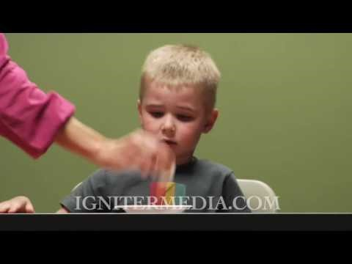
Marshmallow Test
https://www.youtube.com/watch?v=QX_oy9614HQ
Notes:
1.2 Marshmallow Test Overview and Activity (pg. 3)
Start with “We’re going to watch a video. “ Then, without discussion, show the video.
The video creates a fun and surprising start to Mind Matters.
Optional: Pass out marshmallows so that each participant has one marshmallow to hold while watching the video or until the end of class

Slide 5

What can we learn from the Marshmallow Test?
Notes:
Marshmallow Research Study
Social scientists wanted to know what it took to have the emotional control to wait for something and to have patience
Young children were subjects of this research.
How long can a child wait before needing to eat a marshmallow?
Kept track of these children over the next twenty years.

Slide 6

Why couldn’t some kids wait?
Notes:
Discuss the concept of waiting
Why couldn't some kids wait?
Let's brainstorm some reasons why you think they couldn't wait.
If time permits, write their answers on a flip chart/board. There are no wrong answers.
Encourage their answers to include:
Physical hunger
Emotional excitement, especially if someone really likes marshmallows
Mistrust of the person who is supposed to bring the second marshmallow
Experiences with parents or other caretakers not being there so trust is difficult
A general lack of stability in someone's life.
If you grow up in a family where there is not enough to go around, you learn that you better eat it now or there will not be anything for you.
For some people, they believe the word “wait” means “no.”

Slide 7

Let’s talk about the emotional side to waiting.
Notes:
Let’s Talk about the Emotional Side of Waiting
Emotional reactions are quick, almost instantaneous.
A person may not even notice that a decision was made.
Responses include: Increased heart rate, feeling something in your stomach, or muscle tightness, a sudden pause or becoming confused.
Emotional reactions are hard to explain; they vary with each person and situation to situation.
When emotional reactions happen, it might mean that something from the past is interfering with the present.

Slide 8

When do you wish you would have waited?
When were you thankful or proud that you waited?
Notes:
Waiting is a challenge for many.
Most people have had moments when they have been impulsive:
eating the next cookie,
doing something risky,
deciding not to take good care of themselves.
If a person is particularly hungry, angry, lonely, or tired, they are more likely to be unable to wait.
We know there are moments in which quick decisions happen.
These are the times when there is no thought about the consequences.
Questions:
Can you think of times when it would have been better for you to wait?
Or, can you think of a time when you were thankful that you did wait?

Slide 9

Research shows why waiting matters.
Notes:
Discuss the research results
Researchers kept track of these kids for the next twenty years.
They did find some big differences between the lives of the kids who could wait to eat the marshmallows and the kids who couldn't.
What do you think the researchers found about kids who could wait
How were their lives different?
Allow time for brainstorming.
Here is what the researchers found.
Kids who could wait . . .
did better in school, scoring 125 points higher on college entrance exams.
made more money.
were more likely to have long-term, satisfying relationships.
When they redid this study with 65 to 90 year-olds they found, once again, in a study with snacks, that people who could wait lived happier, healthier, and wealthier lives.

Slide 10

People who can wait have skills for success.
Notes:
What skills do people who can wait have that make their lives more successful?
Resilience: This means that they can stay calm and in control when faced with a challenge.
Ability to focus their attention
Control their emotions and impulses
Ability to learn because they have a working memory
Cognitively flexible
These abilities lead to better reasoning, problem-solving, and planning that are necessary for achieving their chosen goals.
People can learn to wait
This research may make it seem like people are doomed to a bad life if they can't wait.
We can grow our brain and build the skills necessary to be able to wait!
These abilities can improve at any time over the course of our lives.
Most of us want the life of a person who can wait. They appear smarter, make more money, have long-term relationships, and are happier.

Slide 11

“Between stimulus and response there is a space.
In that space is our power to choose our response.
In our response lies our growth and our freedom.”
Victor Frankel, holocaust survivor.
Notes:
“Between stimulus and response there is a space. In that space is our power to choose our response. In our response lies our growth and our freedom.”
What does this mean?
With increased space, people can learn how to respond rather than react, which will lead to personal growth and the freedom to choose.
What is the difference between reacting and responding?
When we react:
This might be when someone pushes our buttons
let our emotions take over.
act quickly, without much thought.
heart races, breath quickens, and we might even feel sick to our stomachs.
We often act in a way that we regret.
With these exercises, we can learn how to pause and make a thoughtful response
pause, we slow down, think it through, and realize that we have a choice.
act more from logic and less from emotion.
We call this “making space.”

Slide 12

The purpose of this class is to become someone who can wait.
Notes:
With Mind Matters: we hope to expand that space between stimulus and response in each moment of every day.
Learn skills that are mental exercises.
With practice, these can improve our ability to wait.
The purpose of this class is to become someone who can wait, someone who can pause.
As the research shows, this increases the possibility that we will have a healthier, wealthier, and happier life!

Slide 13
Mind Matters Pinwheel
Notes:
1.3 Focused Breathing (pg. 6)
This is the Mind Matters Pinwheel.
It is also on the back of the Participant Journal.
In this class we will be covering six topics to help us improve our lives.
Each topic is represented on a curl of our Mind Matters Pinwheel.
Self-soothing
Developing an Observing Self
Relationships Skills
Compassion for the Hijacked Brain
Self-Care
Intentionality
Today we start with Self-Soothing.

Slide 14

Today we are going to learn 4 skills that can increase our ability to wait.
Focused Breathing
Peripheral Vision
5-4-3-2-1 Skill
Coloring
Notes:
Learning 4 new skills that:
Increase our ability to wait
Help with Self-soothing
The Skills:
Focused Breathing
Peripheral Vision
5-4-3-2-1 Skill
Coloring

Slide 15
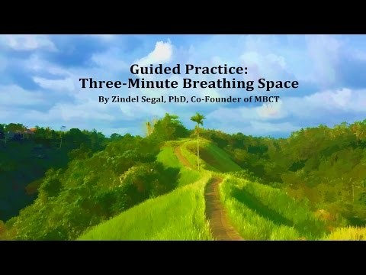
The first skill is Focused Breathing.
Notes:
Self-Soothing Skill 1: Focused Breathing
Purpose of this exercise is to calm the body and quiet the mind.
Studies have shown that consistent practice can change the brain for the better, letting people think rather than become reactive to situations.
Not all exercises work for everyone.
Each person will need to find what works for them.
For example, some people like to have their eyes shut; others like their eyes open.
For some, this exercise may not be effective because the sound of heavy breathing may remind them of a time that was unpleasant or very scary.
If an exercise is making you uncomfortable, stop and sit quietly. If you stop and you are still uncomfortable, raise your hand so we can be helpful to you.
Do Focused Breathing
Play the video Three Minute Breathing Space (4:59) http://www.mindful.org/the-three-minute-breathing-space-practice/
or use the instructions for Focused Breathing in the Toolkit
What are your thoughts about Focused Breathing?
How did it feel?
Any answers are okay. It's important not to judge their experiences.

Slide 16

How can Focused Breathing benefit us?
Notes:
Provide research supporting Focused Breathing
The flight-fight part of the brain decreases.
The thinking, compassionate part of the brain increases.
Our ability to think about difficult situations increases, which reduces our reactivity.
Physical changes: new receptors get built at busy synapses, sensitizing them. These new brain connections grow in a matter of minutes.
The brain cells responsible for troubling thoughts, emotions, and memories begin to wither away.
DNA can begin its creative work, causing growth and strengthened connections within your brain.
We have decreased levels of stress hormones.
Just like repeatedly lifting weights to build a muscle, repeated patterns of mental activity, like Focused Breathing, build new brain structure.

Slide 17
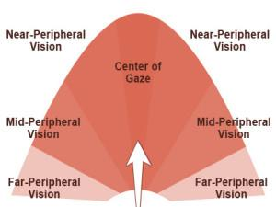
The second skill is Peripheral Vision.
Notes:
1.4 Peripheral Vision (pg. 8)
Self-Soothing Skill 2: Peripheral Vision Exercise
can calm your Vagus nerve
quick and easy
used anytime you are experiencing worry or stress
Peripheral vision is paying attention to what is happening at the edges of your field of vision.
Lead Peripheral Vision Skill
Read the instructions for Peripheral Vision in the Toolkit.
Process Peripheral Vision
How was this experience?
Were you able to keep your eyes focused on one point while also being able to see out of the corners of your eyes?
Practice improves this skill.
You can do this technique any place and time without drawing attention to yourself, such as right before a test, at a job interview, or while waiting in line at a government office.

Slide 18
The third skill is 5-4-3-2-1.
FIVE: | What you see
FOUR: | What you hear
THREE: | What you touch
TWO: | What you smell
ONE: | What you taste
Notes:
1.5 5-4-3-2-1 Skill (pg. 10)
Self-Soothing Skill 3: 5-4-3-2-1 Skill
Purpose 1:
increase mindfulness and build a skill of focused attention
notice the present and all the wonder around you.
focus your awareness on your five senses.
What are the five senses? (Seeing, Hearing, Feeling, Smelling, Tasting)
Purpose 2:
calming exercise, particularly if you are overwhelmed or have even lost track of the present.
get yourself back to the here and now if you are having an unpleasant memory
can be used tool anywhere
Lead 5-4-3-2-1 Skill
Use the instructions for 5-4-3-2-1 Skill in the Toolkit.
Now let’s talk about this skill.
How did that go? Was it easy? Difficult?
How do you feel after doing this skill?
When would you use this skill?

Slide 19

5-4-3-2-1 Skill is also about
MINDFULNESS.
Notes:
5-4-3-2-1 Skill and Mindfulness
Use 5-4-3-2-1 to take a moment to slow down, stop, and pay attention to something of wonder around you.
The way the sun hits the trees, a cool breeze coming through the window on a hot day, the sound of laughter, a child playing nearby, or two people holding hands as they walk—each day is full of rich examples.
Take a moment to find them in your world.
Pause to honor what you have observed
Become aware of whatever feelings surface within.
You may find yourself better able to deal with the stressors you face along the way.

Slide 20
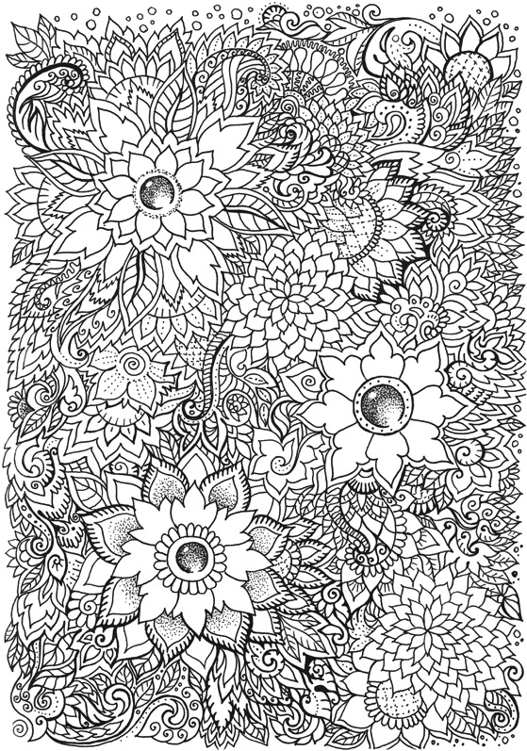

Coloring
Notes:
1.6 Coloring (pg. 11)
Self-Soothing Skill 4: Coloring
Reduce your stress response
Trains your mind to focus on one activity
Focusing on only one activity at a time
improves memory,
reduces emotional reactivity,
improves cognitive flexibility.
Participant Journal has places for you to color or doodle.
You may engage in this activity during class at any time.

Slide 21

Your nervous system does not speak English.
Notes:
Summary, Practice Plan, and Final Skill Exercise (pg. 11)
So, why are we doing all of these self-soothing exercises?
How often do you find yourself saying, “I shouldn’t feel this way?” Or, “Stop it!”
People say to themselves, “Stop being depressed. Be happy. Stop thinking about ----.”
How many of you have experienced this? Everybody does, whether you notice or not.
This is our nervous system talking to us, trying to get us to shut down the arousal, distress, and discomfort we experience.
When you use self-talk to try to control these thoughts, you're using English, or your primary language.

Slide 22
The nervous system is non-verbal.
Your nervous system does not speak English, Spanish, etc.
1
It sends signals and sensations to brain centers
2
The brain interprets these signs and sensation, assigns words and meanings to experience
3
Notes:
The Nervous System:
does not speak or understand English or any other language
non-verbal
operates by sending signs and sensations to the brain centers either with conscious or unconscious awareness
The brain interprets these signals, signs, and sensations and assigns words and meaning to the experience

Slide 23

How to communicate with your brain.
Nervous system communicates in signs and sensations.
To control the system, signs and symbolic practices are necessary
Notes:
How can we communicate with our nervous system so that we can be calmer?
Signs and symbolic exercises are necessary because that is how the nervous system communicates.
To Control the system, we must use signs and symbols.
Methods to Practice :
Sitting quietly while watching the body breathing
Peripheral Vision
These exercises message the nervous system, telling it to reduce its reactivity and return to a more comfortable state.
Exercises that Teach us to Wait and Think Rather than React
Marshmallow research - We learned that waiting is important.
By doing these exercises, we can learn how to wait or to pause, which increases our ability to think rather than react.
The exercises contained in Mind Matters are specifically designed to lead us through daily exercises that increase our ability to wait so that we can respond with emotional control and stability and become resilient.

Slide 24

The Importance of Practice
Notes:
Which exercises seemed to work for you?
Some exercises will work better than others and some will work better with additional practice.
We are starting a new habit of mind.
Learning how to self-sooth and reduce reactivity will take time.
Being able to stay calm and in control when facing a challenge is one of the key factors in being able to bounce back from difficult experiences—resilience.
If we do these exercises every day throughout this program, we will experience some changes.
Over time we will learn how to create a sense of peace and calm.
Try these methods to discover which one works best for you, both in and outside of class.
These exercises took only approximately four minutes or, in some cases, 10 seconds!
Try the breath work four times a day.
You can use the peripheral vision every ten to fifteen minutes for ten seconds if you want!

Slide 25

Try the Cell Phone Challenge
Notes:
Cell Phone Challenge
For those of you who want some extra practice with waiting.
How many of you get a tone when someone texts you?
Have any of you been checking your phone even during this class?
How long do you wait before checking your phone to read the text?
For most of us, we check immediately, without thought.
Do you think you can increase the amount of time that you wait before checking your phone?
I challenge you to count how many seconds you can wait and see if you can increase that amount of time.
Also, notice what you are doing when you can wait and when you can't wait.
Does it matter if you are bored, tired, hungry or happy, content, or involved in a meaningful activity?

Slide 26
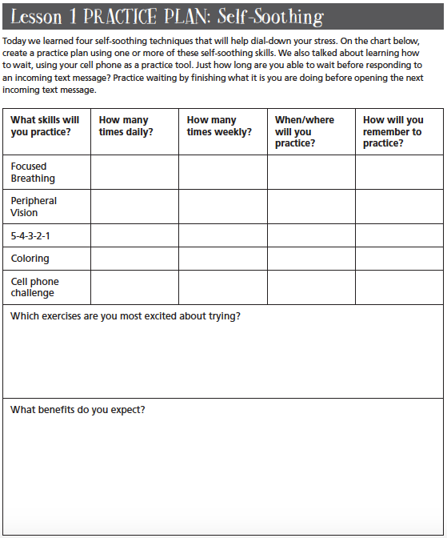
Time to make a plan for practice!
Notes:
The Participant Journal
Assist you in learning and practicing new skills
Confidential – Nobody will look at it including me.
Kept in a safe place between sessions
You will receive it after the program
Great tool to continue practice after the program ends
Look in your journal at Lesson 1 on page 6.
list of the exercises that we did today.
complete this page to set goals for which skills you will practice, when, and how often.
When we put our goals in writing, we are often more likely to follow through.
Free Cell Phone Apps
These apps can help you increase the quantity and quality of your exercises and also help you track your practice.
www.stopbreathethink.org/
https://www.calm.com/
http://smilingmind.com.au/
Instructor: If possible, download an app on your phone and show the students.
If time permits, ask them to share their plan with the person sitting next to them.

Slide 27

Time for practice.
Notes:
Final Self-Soothing Skill
We believe so much in the importance of these skills that we are going to begin and end every class with a self-soothing skill.
Close your journals so that you can take a minute to participate.
Depending on time, you can allow the participants to pick the self-soothing skill: Focused Breathing, Peripheral Vision, or 5-4-3-2-1 Skill.
Lead skill using directions from the Toolkit.
Thank you for your presence today and I look forward to our next class!
And remember that with practice, we can learn to wait and then increase our chances of living the life we desire.

